Slide 1
ECE 50874/595: Advanced Software Engineering
Risk mitigation via Redundancy
Does redundancy work in SE?
Prof. James C. Davis, Prof. Santiago Torres-Arias
Elmore*

Slide 2
Introductory remarks

Slide 3
LEGAL DISCLAIMER
The materials for this unit include excerpts from IEC 61508. If you are participating in this class, you have student access to IEC 61508 through the USA’s ANSI organization, and therefore can view this content. If you are no longer participating in the class (eg because the semester has ended), please do not access this material unless you re-obtain access to IEC 61508 through some other means.
If you access IEC 61508 inappropriately via these slides, it could harm the ability of future iterations of this course to access international standards for educational purposes. Please be good!
~JD
As of Spring 2024, access to the IEC 61508 family costs ~$3000 USD. Thanks ANSI!

Slide 4
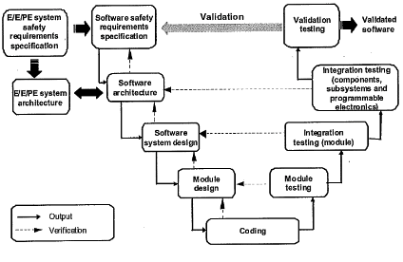
61508-3-Figure 6
Software systematic capability and the development lifecycle (“V-model”)
Notes:
We’re going to work our way through the general and specific techniques recommended by 61508, following the stages of the V-model.

Slide 5
A comparison of 61508’s position of redundancy and diversity for SW vs HW
“When the formula to be computed is very complicated, it may be algebraically arranged for computation in two or more totally distinct ways, and two or more sets of cards may be made. If the same constants are now employed with each set, and if under these circumstances the results agree, we may then be quite secure of the accuracy of them all.” – C. Babbage, 1837
Notes:
Babbage articulated the intuition behind design diversity almost 200 years ago.
“If we compute it two totally distinct ways and they agree, we should be secure.”
Let’s see the position that 61508 takes on this matter.

Slide 6
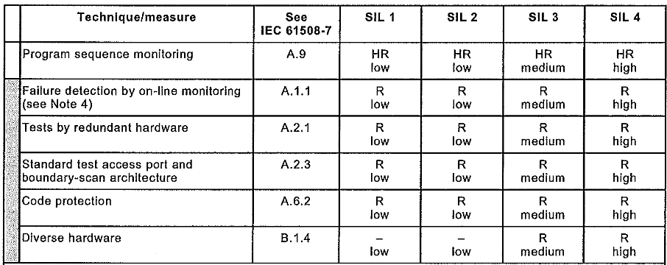
61508 Part 2, Table A.15 – Techniques & measures to control Systematic failures caused by HW design
Redundant compute: Distinct channels perform redundant computation, e.g. 2oo3 voting
Watchdog: A HW monitor confirms liveness of the HW that should be acting
Design diversity: Two or more items carrying out the same function but differing in design
Functional diversity: Two or more items carrying out different functions for same safety goal
Notes:
SLIDE CONTEXT – PART 2, HARDWARE SYSTEMATIC FAILURE MITIGATION
Before we talk about diversity in software, it is instructive to contrast with IEC 61508’s position on diversity in hardware.
Part 2 describes the considerations for high-assurance hardware design in safety-critical contexts.
We will use this hardware framing as a baseline before examining the software analogue in Part 3.
In Part 2, the companion table of Part 3’s Table A.2 (techniques to control systematic failures) is Table A.15.
In Part 2, 61508 acknowledges two different forms of redundancy or diversity.
TESTS BY REDUNDANT HARDWARE (A.2.1)
This technique uses two or more hardware channels that support the same safety function.
The purpose is runtime fault detection through replication.
Lower rigor: temporal supervision
Program sequence monitoring or watchdogs confirm liveness or timing behavior.
These monitors check that the hardware acts within a required time window.
For example, a watchdog timer might reset or shut down a controller if it fails to toggle a heartbeat signal within a specified deadline.
This is temporal supervision rather than logical comparison of full functionality.
Higher rigor: replicated computation with voting
Distinct channels compute the same safety function and their outputs are compared or voted.
This allows detection of logical discrepancies, not just missed deadlines.
A common example is a 2-out-of-3 architecture with a majority voting rule to resolve conflicts.
DIVERSE HARDWARE (B.1.4)
This technique uses architectural diversity to reduce common-cause or systematic hardware design faults.
The purpose is to reduce the probability that a single design error defeats the safety function.
Lower rigor: design diversity
Two or more hardware items carry out the same safety function but differ in design.
The implementations may use different processors, architectures, toolchains, or development teams.
Each channel satisfies the same safety requirements independently.
The intent is to reduce the likelihood of common-cause systematic faults affecting all channels simultaneously.
Higher rigor: function diversity
Different hardware items carry out different protective functions for the same safety goal.
The mechanisms may rely on different sensing principles or different physical effects.
Each function independently contributes to hazard mitigation.
This reduces the chance that a single failure mode disables all protection layers.
For example, in the context of an industrial reactor, you could detect over-temperature using an electronic temperature sensor and independently detect over-pressure using a mechanical relief mechanism.
Both of these would support the detection of an unsafe operating condition characterized by high temperature and high pressure, which often occur together, but through different observable physical effects.

Slide 7
The math behind the HW redundancy guidance
Suppose we use the redundant compute method (1 out-of 2 voting)
Suppose we want to reduce Prob(failure) to reach SIL 1: PFH < 1E-5
Model/Assumption: Suppose the failures are independent.
→ What PFH do we need to achieve for each component?
→ What is it for SIL 2 and 3?
Is the assumption sound? When might it fail?
If we move to design diversity,
how does it affect the problem statement?
SIL | Avg freq of dangerous failure per hour (PFH)
4 | < 1 E-8 but >= 1 E -9
3 | < 1 E -7
2 | < 1 E -6
1 | < 1 E -5
Notes:
In-class activity: Work out the math here.
For the math, see the hidden spreadsheet on Brightspace – “4-2-RedundancyInSE-1oo2Analysis.xlsx”.
ANIMATE
Q: Soundness of assumption/failure model?
(In other words, is the assumption of independence reasonable? When might it fail?)
A: The independence assumption fails under common-cause faults.
This answer is a bit tautological, of course, but certainly realistic. Shared or non-independent defects can arise from manufacturing, design, environment, or tooling.
Example 1: We receive a batch of sensors fabricated with a subtle defect.
All sensors drift high under certain temperature conditions.
Both channels therefore fail in the same direction at the same time.
Example 2: A fabrication process error introduces incorrect doping in a semiconductor batch.
All chips share the same latent weakness and fail under high voltage stress.
Even though the channels are redundant, their failure modes are correlated because they share the same physical defect.
So if the failures may be correlated, what is the PFH of the system now?
(System PFH = p, not p^2, because the failure of one component implies the failure of the other).
The square-law benefit disappears.
ANIMATE
Q: How does design diversity affect the problem statement?
A: Design diversity changes the statistical model.
We’re reducing the probability of correlated failures using alternative designs.
Thus we can no longer assume both channels have identical failure rate p.
Under independence, system PFH ≈ p₁ × p₂.
It’s the same “potential square-root reduction” in PFH, but we now need to measure and control two failure rates instead of 1.
Design diversity attempts to make the independence assumption more plausible, but comes at a higher cost.

Slide 8
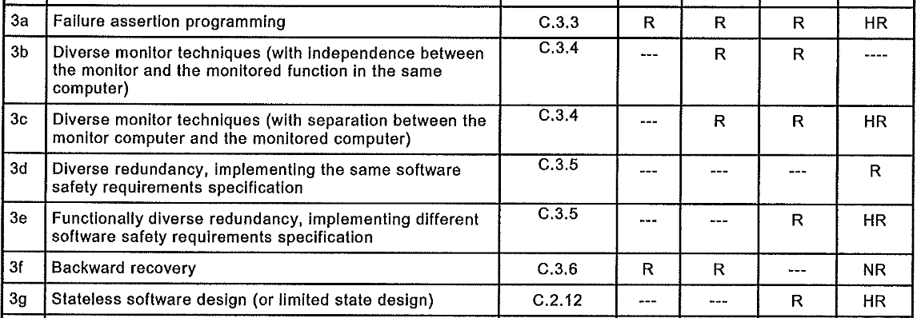
Diversity/Redundancy in Table A.2: SW D&D – SW Arch. Design
Watchdog: A SW monitor confirms liveness of the SW that should be acting
3. “Fault-tolerance via diversity and state control”
Design diversity: Two or more items carrying out the same function but differing in design
Functional diversity: Two or more items carrying out different functions for same safety goal
Notes:
SLIDE CONTEXT – PART 3, SOFTWARE DIVERSITY AND REDUNDANCY
We just examined how Part 2 treats redundancy and diversity in hardware.
Now let’s look again at the companion table in Part 3.
In Part 3, Table A.2 addresses systematic failures in software architecture and design.
We talked about this last time.
Today I want to focus on the techniques associated with redundancy and diversity.
At first glance, everything is the same.
ANIMATE
First, we see diverse monitor techniques.
This is the software analogue of hardware supervision and monitoring.
In 3b, the monitor is independent within the same computer.
The monitor checks the behavior of the main function but is architecturally separated.
In 3c, the monitor is separated onto a different computer.
This increases independence at the system level.
These techniques primarily provide fault detection through supervision.
The monitor does not replace the main function.
It detects abnormal behavior and can trigger a safe state.
DESIGN DIVERSITY – SAME REQUIREMENTS (3d)
Now we move to 3d, diverse redundancy implementing the same software safety requirements.
This is the direct software analogue of hardware design diversity.
Multiple versions implement the same specification.
The intent is that independent development reduces the chance of common-cause design faults.
FUNCTIONAL DIVERSITY – DIFFERENT REQUIREMENTS (3e)
Last we have 3e, which is functionally diverse redundancy implementing different software safety requirements.
This parallels functional diversity in hardware.
Different software components protect the same safety goal using different logic.
For example, one component may verify message integrity using a checksum.
Another independent component may apply semantic plausibility checks to the decoded values, such as range limits or rate-of-change checks (eg if you know the vehicle’s maximum acceleration, you can sanity check the delta between two consecutive readings).
A checksum will detect many forms of accidental corruption during message transmission, but it does not reason about meaning.
A plausibility check reasons about meaning, and can catch unsafe or impossible values whether they arise from sensor faults, software bugs, or some corruption patterns.
In other words, a plausibility check is not a complete integrity mechanism, and a checksum does not guarantee semantic correctness.
Together, these mechanisms provide overlapping but non-identical coverage, which is the point of functional diversity.
DIVERSITY IN HARDWARE VS SOFTWARE
At this point, it’s tempting to say the story about redundancy and diversity is the same in hardware and software.
(move on to the next slide)

Slide 9

Design diversity: SIL recommendations for HW vs SW
Hardware
Software
→ Design diversity is considered safer in HW than in SW ←
Think-pair-share: Why might this be?
Notes:
Well, the techniques are the same – that part makes sense – but the recommendations by SIL levels differ at one point.
For redundancy via watchdogs, the SIL recommendations are comparable.
For functional diversity (different systems performing complementary functions), the SIL recommendations are comparable.
But for design diversity (different design/implementation of the same function), the SIL recommendations diverge.
Let’s take a look side by side.
In hardware, diverse design is recommended starting at SIL 3.
In software, diverse redundancy implementing the same safety requirements is only recommended at SIL 4.
ANIMATE
In other words, IEC 61508 appears more confident in hardware design diversity than in software design diversity.
The structure is the same.
The mathematical framing seems like it should be similar.
But the standard’s level of endorsement is different.
ANIMATE
Why do you think this might be?
Take 2 minutes to form your own opinions, and 3 minutes to discuss with a partner.
Ground your conversation in the mathematical analysis we did earlier for 1-out-of-2 independence.
(This conversation needs to result in someone asking:
“will multiple SW design/impl. be independent in the same way that multiple HW will be?”
for the rest of the lecture to flow well)
CLOSING
The difference is not accidental.
It reflects deeper assumptions about how independence behaves in hardware versus software.
Why? That take us directly to the papers we’ll talk about today.

Slide 10
Design Technique: Diverse Redundancy With the Same Specification
Notes:
Making multiple versions of software — often called n-version programming — entails substantial cost.
We are not just duplicating code.
We are paying two or three times the initial development cost.
We are also paying two or three times the long-term maintenance, testing, and evolution cost.
We must manage separate codebases, separate defect streams, and separate updates.
This is not a minor architectural tweak.
It is a major organizational commitment.
If we truly obtain a square-law reduction in failure rate, the cost may be justified.
If the independence assumption holds, the reliability improvement can be dramatic.
But if failures are correlated, or if independence is hard to justify or model, then the economic argument weakens.
The entire case for n-version programming hinges on whether independence is real.
That is the question we are about to examine.

Slide 11

Experimental design
Suppose you are a member of the IEC trying to fill out the recommendations in this SIL table yourself.
Design an experiment to help you guide engineers.
What is your definition of “independent failures”?
Hypothesis / null, and rationale
Study design
Subjects and Independence
Tasks
Metrics
4 minutes: Design
3 minutes: Pair with partner
5 minutes: Readout
Notes:
SETUP
We have just argued that the square-law benefit of redundancy depends on independence.
IEC appears less confident in software design diversity than in hardware design diversity.
One reason for the asymmetry is a famous series of experiments that were performed in the 1990s and 2000s.
I want you to imagine that it’s 1992 and you’re working on the first draft of IEC 61508, due out in 1998.
You are being asked to make recommendations in the SIL table.
You do not get to rely on intuition.
You need evidence.
I want you to describe a controlled experiment that would give you the evidence you need to make a recommendation.
TASK FRAMING
Your goal is to design an experiment that tests whether independently developed software versions fail independently.
Be precise.
What does “independent failures” mean in operational terms? (Examples below as needed)
Independent per input?
Independent per failure event?
Independent across time?
Define your random variable clearly.
(Reminder…) A random variable is a formally defined measurable outcome of interest in an experiment, such as whether a given team’s implementation fails on a particular test input.
HYPOTHESIS
What is your null hypothesis?
If you believe independence holds, then your null is that failures are statistically independent.
What would the alternative hypothesis be?
- Positive correlation?
- Shared failure patterns?
Be explicit.
DESIGN
Who are your subjects? (Examples below as needed)
Professional engineers?
Students?
Multiple teams?
How do you ensure they are truly independent? (Examples below as needed)
Separate rooms?
Separate tools?
No communication?
TASKS
What problem do they implement?
How complex?
How safety-relevant?
How do you ensure the task is hard enough to induce realistic errors?
What specification to use?
METRICS
How do you measure failure? (Examples below as needed)
Incorrect output?
Violation of a safety property?
Failure under specific test cases?
How many test cases do you need?
How will you detect correlated failures?
TIMING
You have four minutes to sketch a design individually.
Then three minutes to compare with a partner.
Then we will hear from a few groups.
Ground your reasoning in the p² model we just derived.
INCLUDING FALSIFICATION IN THE DISCUSSION
So far we’ve talked about study design in a classical empirical sense — gather observations, run experiments, accumulate evidence — very much in the spirit of Francis Bacon.
In modern philosophy of science, we add an additional criterion: falsifiability.
This idea was popularized by Karl Popper, whose central thesis was that a scientific claim must make testable predictions that could, in principle, be proven wrong.
It is not enough to accumulate confirming evidence.
A good hypothesis exposes itself to the risk of refutation.
Let’s apply that thinking to the independence assumption behind diverse redundancy.
If we claim that independently developed versions fail independently, what empirical result would force us to abandon that claim?
What would count as disconfirming evidence?
If you observe multiple teams failing on the same inputs, what does that imply?
How much correlation would you tolerate before you reject the independence model?

Slide 12
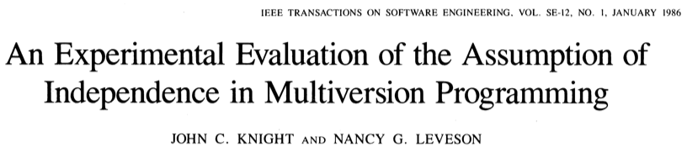
The real experiment
Panel discussion at Purdue, 2022, after a talk by Nancy G. Leveson:
https://engineering.purdue.edu/Engr/AboutUs/News/Events/DistinguishedLectures/2022-2023/nancy-leveson-panel
Notes:
You just designed an experiment to test independence in N-version programming.
In 1986, Knight and Leveson published a famous paper that did exactly that.
N-version programming had already been proposed and advocated as a practical fault-tolerance technique, especially by Avizienis and others in the 1970s and early 1980s.
The central claim in that prior work was that independently developed software versions would fail independently, making majority voting highly effective.
However, the independence assumption had largely been treated as plausible rather than empirically demonstrated.
In other words, previous analytical models typically assumed independence as a premise (like we did earlier for HW) rather than testing it.
With that said…prior experimental reports do suggest low rates of identical faults across versions.
Discussion Question: Is “low rates of identical faults” sufficient?
Knight and Leveson note that the real question is not whether faults are identical in the code, but whether failures are statistically independent at runtime.
Their contribution was not in proposing N-version, but in experimentally evaluating its key underlying assumption.
They wrote: “From an operational viewpoint, it does not matter why programs fail on the same input, it merely matters that they do. Thus in examining the hypothesis of independence, we examine the observed behavior of the programs during execution.”
In other words, as long as the N versions all fail on a given input, it doesn’t matter why – the defects can occur for different implementation-level reasons, but would still compromises the hypothesis of independence if the defects are correlated.
1. What is their definition of “independent failures”?
They adopt the statistical definition of independence:
Two versions fail independently if, for any input,
\Pr(A \mid B) = \Pr(A)
and vice versa — i.e., knowing that one version failed does not change the probability that another fails (Sec. V).
Operationally, they test independence at the level of coincident failures on the same test input.
The key observable is whether two or more versions fail on the same test case, regardless of whether the underlying faults are identical .
Importantly, they analyze failures during execution, not source-code fault similarity. From a fault-tolerance standpoint, what matters is coincident erroneous outputs, not identical bugs .
2. Hypothesis / Null, and Rationale
Null Hypothesis (H₀)
Failures of independently developed versions are statistically independent.
Given:
Individual failure probabilities p_1, \dots, p_N,
The derived probability P_{more} that more than one version fails on a given test case,
Then the number K of test cases with multiple failures should follow a binomial distribution with parameter P_{more} (Sec. V).
Rationale
Much reliability analysis of N-version programming assumes independence, yielding the “square-law” reliability improvement (system failure probability proportional to p^N) (Intro).
If independence is false, reliability analyses based on it will overestimate system reliability (pp. 96–97).
3. Study Design
27 independently written versions
All from the same requirements specification
Each subjected to 1,000,000 randomly generated test cases representing a lifetime operational profile according to engineers consulted at Boeing
Outputs compared against a trusted “gold” version (Secs. II–IV)
A failure was recorded if:
Any of 241 outputs differed from the gold version, or
An execution exception occurred (Sec. IV).
Crucially:
Each version had its own acceptance test (to avoid filtering shared faults through a common test set).
A gold program enabled automated checking at scale .
4. Subjects and Independence
Subjects
27 students (9 UVA, 18 UCI)
Undergraduate through PhD level, including professional engineers coming back for further study.
Mixed backgrounds, varied programming experience (Sec. III)
Independence Controls
Explicit instructions not to discuss the assignment
Separate universities (~3000 miles apart)
Same specification, but:
No imposed methodology
No shared acceptance test
Freedom to consult references independently (Sec. II)
They deliberately attempted to approximate real-world independent development.
5. Task
The “Launch Interceptor” problem:
Radar-based threat detection
15 parameterized logical conditions (LICs)
Geometric computations (angles, areas, collinearity)
Boolean aggregation logic (Sec. II, Appendix)
Chosen because:
Realistic safety-critical flavor
Previously used in NASA reliability studies
Known sources of subtle geometric and numeric difficulty .
Solution programs ranged 327–1004 LOC (Sec. VII).
6. Metrics
Primary Metric
Number of test cases in which:
More than one version failed on the same input.
Let:
N = 27
n = 1{,}000{,}000
K = observed coincident failures.
From the paper:
Observed K = 1255 test cases with multiple failures (Sec. V).
Test statistic:
z = 100.51
This far exceeds the 99% critical value (2.33).
Result:
Reject independence at >99% confidence .
Results Summary
Individual versions were extremely reliable (most >99.9%) (Table I).
Yet coincident failures were far more frequent than independence predicts.
Some test cases caused up to 8 of 27 versions to fail simultaneously (Table II).
Correlated failures occurred across universities, not just within one group (Table III).
Conclusion (their wording summarized)
For this problem, the independence assumption does not hold, and N-version reliability analysis must account for dependent failures (Sec. VIII).
If useful for your class flow, the cleanest takeaway sentence is:
They did exactly the experiment you just designed — and the data rejected the independence assumption by an overwhelming statistical margin.

Slide 13

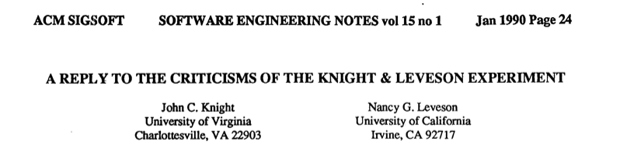
Experimental evaluation of the assumption of independence
Eckhardt Jr, D.E., Caglayan, A.K., Knight, J.C., Lee, L.D., McAllister, D.F., Vouk, M.A. and Kelly, J.P., 1990. An experimental evaluation of software redundancy as a strategy for improving reliability (No. NAS 1.15: 102613).
Notes:
AFTERMATH OF THE 1986 PAPER
Knight & Leveson’s 1986 result challenged the core conjecture of N-version programming: that independently developed versions fail independently.
That conclusion triggered significant pushback from the fault-tolerance community, which had been working with this assumption for a decade.
Subsequent work by Eckhardt and colleagues at NASA collected additional empirical data on multi-version software.
Their results also indicated that failures were not statistically independent.
In particular, misunderstandings of key points in the specification contributed to coincident failures across versions.
In other words, different teams misinterpreted the same requirement in similar ways.
This reinforced Knight & Leveson’s core observation: correlated failures can arise even when development efforts are independent.
ENTER AVIZIENIS (UCLA) AND CRITICISM
At the same time, Algirdas Avizienis and his collaborators — major proponents of N-version programming — disagreed with the interpretation and implications of the 1986 study.
They argued that:
Identical faults across versions were rare.
With proper N-version methodology, independence could still be achieved.
The Knight & Leveson setup did not reflect ideal multi-version development practice.
This led to a public exchange.
THE CRUCIAL DISTINCTION
Knight & Leveson’s 1990 reply (it’s on Brightspace as a reading and it’s really interesting) clarifies the central issue.
They argue that the relevant factor is not whether faults are textually identical.
The relevant factor is whether failures are COINCIDENT AT RUNTIME.
Why? Because when you use these multiple versions, you do so in voting – and voting compares outputs, not source code.
As two entirely different faults can produce the same incorrect output on the same input….From the perspective of fault tolerance, that is what matters.
WHAT WAS REALLY AT STAKE
This was not just a methodological disagreement.
It was a disagreement about whether the independence assumption can be safely treated as given.
If failures are correlated, the square-law reliability improvement disappears – or at any rate becomes much harder to model.
And if the square-law benefit disappears, the economic and safety justification for N-version programming weakens substantially.
WHY THIS MATTERS FOR IEC 61508
When IEC appears more cautious about design diversity in software than in hardware, it is operating in the shadow of this empirical debate.
The standards committees are implicitly acknowledging that independence in software cannot simply be assumed.
And that is the intellectual context for the asymmetry we observed earlier.

Slide 14
Friday’s lab
We will attempt to replicate the Knight & Leveson experiment on N-version programming
This time, using LLM-based agents
(No, I don’t have any idea what will happen, yes, you’re just doing an experiment I’ve been curious about for awhile)

Slide 15
Friday’s lab

